Slide 1


Object Oriented PHP & MVC
What Is MVC?

Slide 2
What Is MVC?
Model View Controller
Software architectural design pattern
One of the most frequently used patterns
Separates application functions
Promotes organization

Slide 3
The Model
Data related logic
Interacts with the database (SELECT, INSERT, UPDATE, DELETE)
Communicates With Controller
Can sometimes update the view

Slide 4
The View
What the user sees in the browser (UI)
Usually consists of HTML/CSS
Communicates with the controller
Can be passed dynamic values from controller

Slide 5
The Controller
Receives input from the url, form, view, etc
Processes requests (GET, POST, etc)
Gets data from the model
Passes data to the view

Slide 6
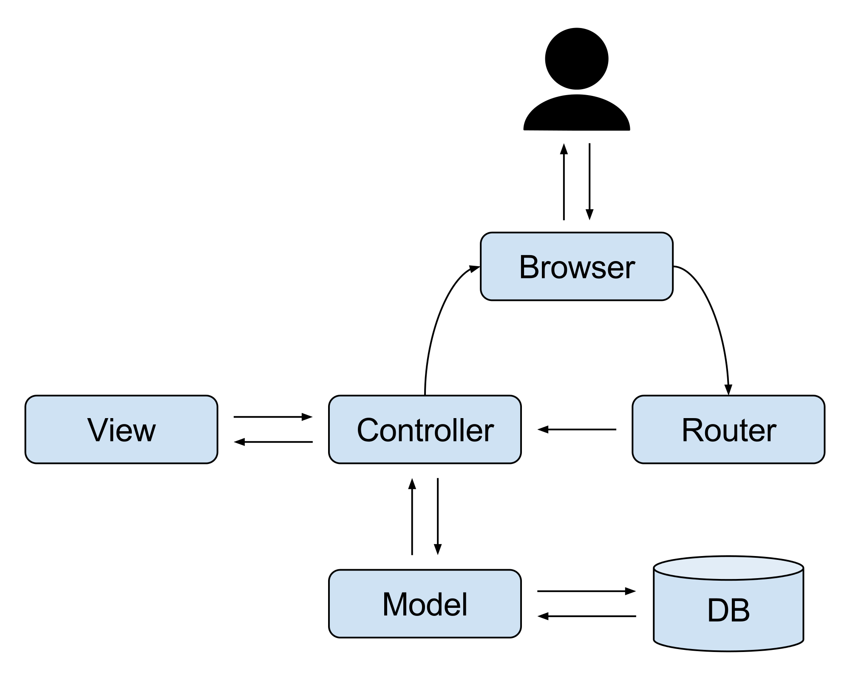
MVC

Slide 7
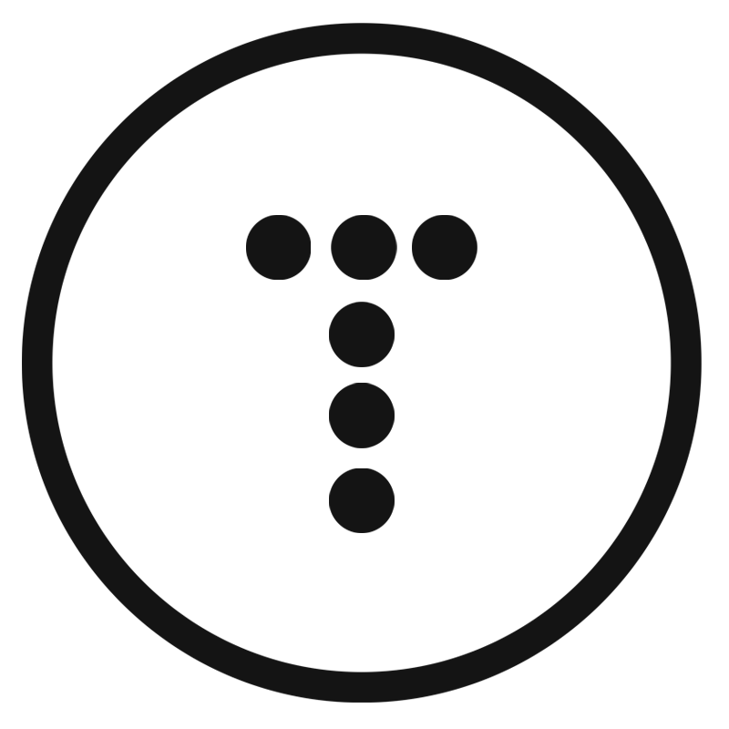

FOLLOW BRAD:
Youtube.com/c/traversymedia
Facebook.com/traversymedia
Twitter.com/traversymedia
Linkedin.com/in/bradtraversy
Thank You
For Watching!
www.traversymedia.com

